Slide 1
Disabilities Awareness

Slide 2
Disability Awareness
Topics

Slide 3
Topics
People First
Agencies
Activities and Adaptations
Accessibility
Advocacy, attitudes, and awareness
Career Opportunities

Slide 4
People First
People who have disabilities are not defined by their disabilities.
Person-First Language
The condition and the person are not one and the same.
Notes:
Your friends, teammates, and classmates have separate personalities, distinct interests and ideas, and different physical features. You do not all look alike, think alike, or act alike. You have your own needs skills and strengths, and your own needs and situations.
People who have disabilities are no different from the members of your group or any other group of individuals.
People who have disabilities are not defined by their disabilities.
Person-First Language
The idea behind person-first language is to emphasize the person, not the disability.
Try to always put the person first when you talk or write about people who have disabilities.

Slide 5
Say | Instead of
Person with a disability | Disabled person
People with disabilities | The disabled or the handicapped
Disability | Handicap
Person who has epilepsy, autism, a spinal cord injury, etc. | An epileptic, an autistic, a quadriplegic, etc. (never identify people only by their disability. A person is not a condition)
Seizure | Fit
Person who is deaf or hard of hearing | Hearing-impaired person
Person with Down syndrome | A Down’s person
Has a cognitive or developmental disability | Is retarded or slow
Has had a disability since birth, or was born with a disability | Has a birth defect
Wheelchair user/person who uses a wheelchair, or person who uses or walks with crutches | Confined/ restricted to a wheelchair; wheelchair-bound (Calling people who are not disabled “healthy” suggests that people with disabilities are unhealthy. In fact, many people who have disabilities are in excellent health. Similarly, labeling nondisabled people as “normal” incorrectly implies that people who have disabilities are “abnormal”)
People without disabilities/nondisabled | Healthy, normal, able-bodied
Accessible parking/ accessible restrooms | Handicapped parking/handicapped restrooms
Notes:
Here are some examples of Person-First language

Slide 6
People First
Disability Etiquette
Here are some tips for disability etiquette:
Smile and say hello
When you talk with someone who has a wheelchair, sit down so you will be at eye level with the wheelchair user
Do not lean on a person’s wheelchair
Do not touch or move a person’s wheelchair, crutches. Cane, or other gear without permission
Look at and speak with the person not the interpreter
Be patient
Notes:
1. When you meet someone who has a disability, it is always appropriate to smile and say hello. You may also offer to shake hands (shaking hands with the left hand is ok). While people with artificial limbs or limited use of their hands do shake hands, remember that not everyone can. When in doubt, ask the person whether he or she would like to shake hands with you.
2. When you talk with someone who has a wheelchair, sit down so you will be at eye level with the wheelchair user. This is not only polite, but it shows the same level of respect with which you would like to be treated.
3. Do not lean on a person’s wheelchair
4. Do not touch or move a person’s wheelchair, crutches. Cane, or other gear without permission
5. If a sing language interpreter helps you talk with a person who is deaf, look at and speak with the person not the interpreter. In fact, any time you talk with a person who has a disability, speak directly to that person rather than to any companion who may be along.
6. Be patient if a person with a disability take a little extra time to do or say something.

Slide 7
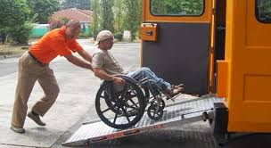
People First
Disability Etiquette
Here are some tips for disability etiquette:
Never pretend to understand if you do not
Speak in a normal voice
Never pet or play with service animals such as guide dogs
Ask before giving help
Offer your arm to a person who has a visual impairment
Notes:
1. When you talk with someone who has difficulty speaking, never pretend to understand if you do not. If you don’t catch what was said, ask the speaker to repeat it, then tell the speaker what you understood. The person will correct or clarify things if necessary.
2. Speak in a normal voice. Do not shout. Shouting hinders lip-reading and distorts the sounds that hearing aids pick up. Obviously, it does not help to shout at people who are blind or visually impaired. They might not see you, but they can hear you.
3. Never pet or play with service animals such as guide dogs. Service animals are working animals, not pets, and should not be distracted from their duties.
4. Ask before giving help. If the person accepts your offer of help, wait for instructions or ask how you can help.
5. Offer your arm to a person who has a visual impairment, or suggest that the person put a hand on your shoulder. This will let you guide, rather than push or pull, the person as you walk together. Give warning of doors, stairs, or curbs as you approach them.

Slide 8
People First
Disability Etiquette
Here are some tips for disability etiquette:
Get their attention, make eye contact, speak clearly
When talking with someone who is blind, identify yourself and anyone with you by name
Relax and be yourself
If you want to know about someone’s disability, it is ok to ask, politely.
Treat people with friendship and respect
Notes:
When talking with someone who is deaf or hard of hearing, first get the person's attention with a light tap on shoulder, or wave your hand or stand in front of the person and make eye contact before you speak. If the person lip-reads, face him or her directly. Speak clearly and not too fast. Let the person choose the means of communication, such as lip-reading, sign language, or writing notes.
2. When talking with someone who is blind, identify yourself and anyone with you by name. when you are ending the conversation or getting ready to leave, let the person know. Don’t just walk away.
3. Relax and be yourself. It is fine and natural to use common expressions such as “did you hear about…?” or “see you later” or “got to run.” Everyday language does not offend people who are deaf or blind or use wheelchairs, and is understandable to most people with mental disabilities. Picking your words with too much care will make everyone self-conscious and uncomfortable.
4. If you want to know about someone’s disability, it is ok to ask, politely. It is also ok for the person not to talk about it.
5. Treat people with friendship and respect. A scout is courteous. Show courtesy to all people, those with and those without disabilities.

Slide 9
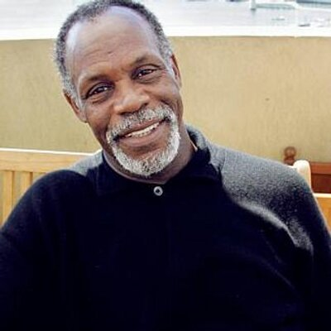
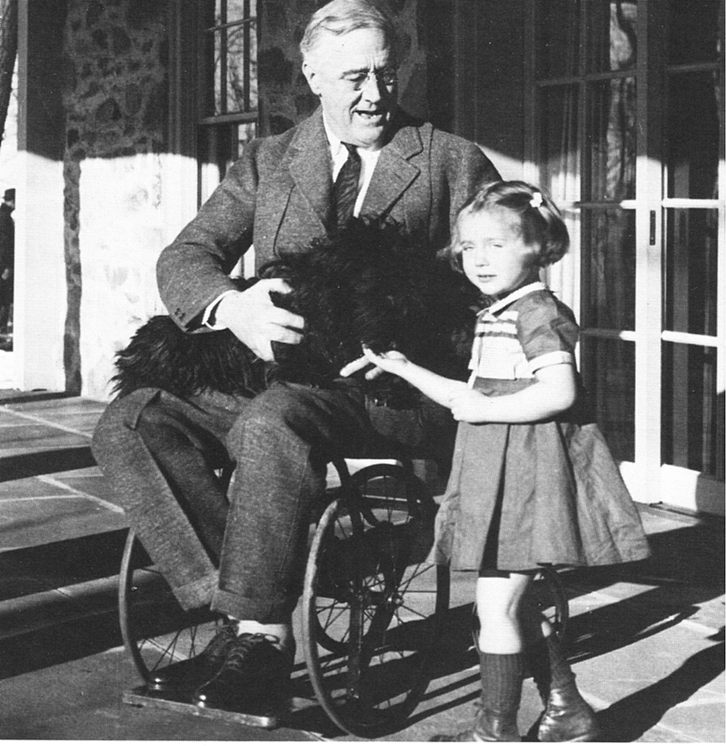
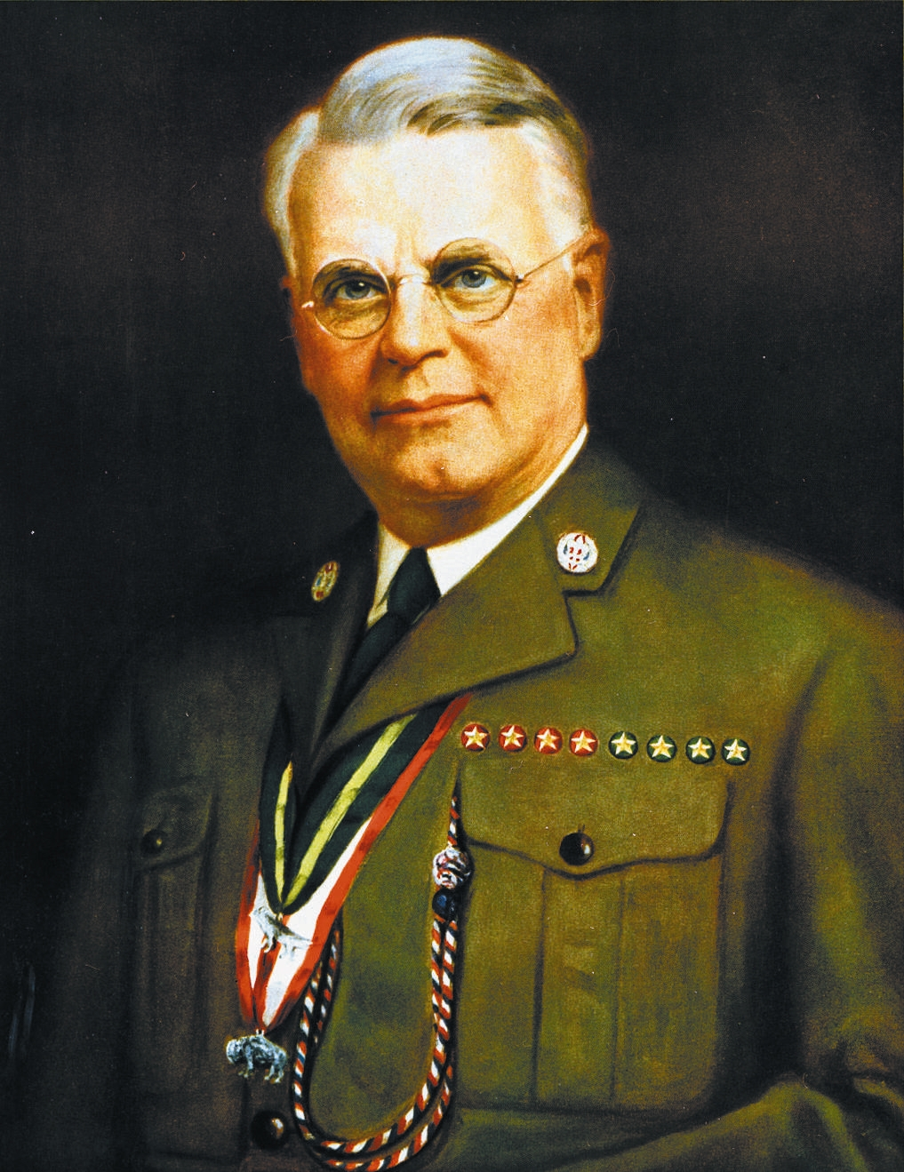
Who Are People With Disabilities?
Danny Glover
Franklin D. Roosevelt
James E. West
Notes:
Danny glover, star of films such as “lethal weapon” series, is a full time activist for such causes as anemia awareness, the AIDS crisis in Africa, and math education in the United States. He has dyslexia.
Franklin D. Roosevelt, who served as president of the United States longer than any other president, used a wheelchair most of his life after nearly dying from polio.
James E. West, successful attorney and the fist chief scout of America, had a disease in one leg that gave him a permanent physical disability.

Slide 10
Disability Awareness
Agencies

Slide 11
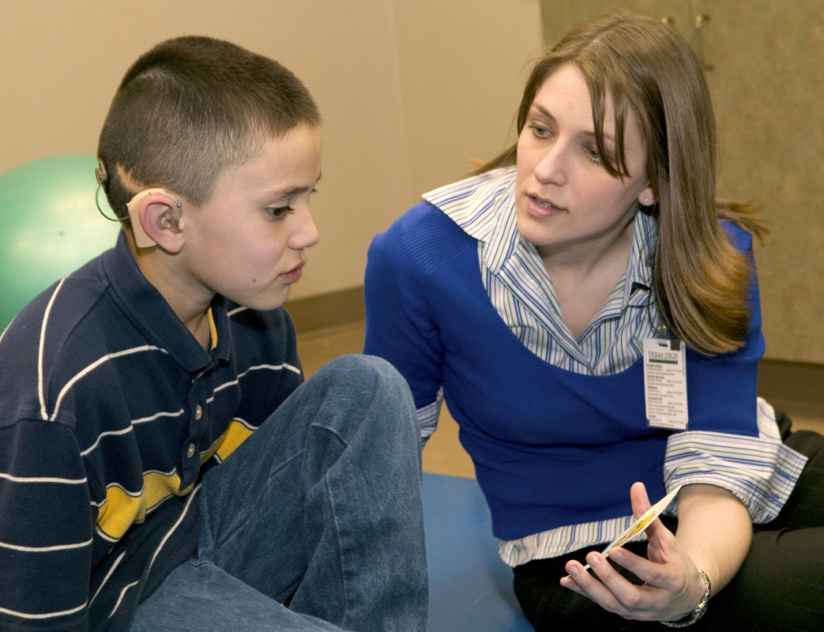
Agencies
Services offered might include the following:
Physical therapy
Speech-hearing therapy
Occupational therapy
Educational programs
Skills training
Employment services
Notes:
Physical therapy: to develop or restore movement, strength, or flexibility lost because of an injury, an illness, or a physical condition.
Speech-hearing therapy: to improve or recover limited or lost communication skills, treat disabilities such as language delay and stuttering, and to teach other ways of communication to people who are unable to speak or hear
Occupational therapy: to develop the ability and independence to do everyday activities such as bathing, dressing, and eating
Educational programs: matched to students’ ages, needs, and abilities
Skills training: to build skills that people need at work
Employment services: to help people find the kinds of positions they want

Slide 12
Disability Awareness
Activities and Adaptations

Slide 13
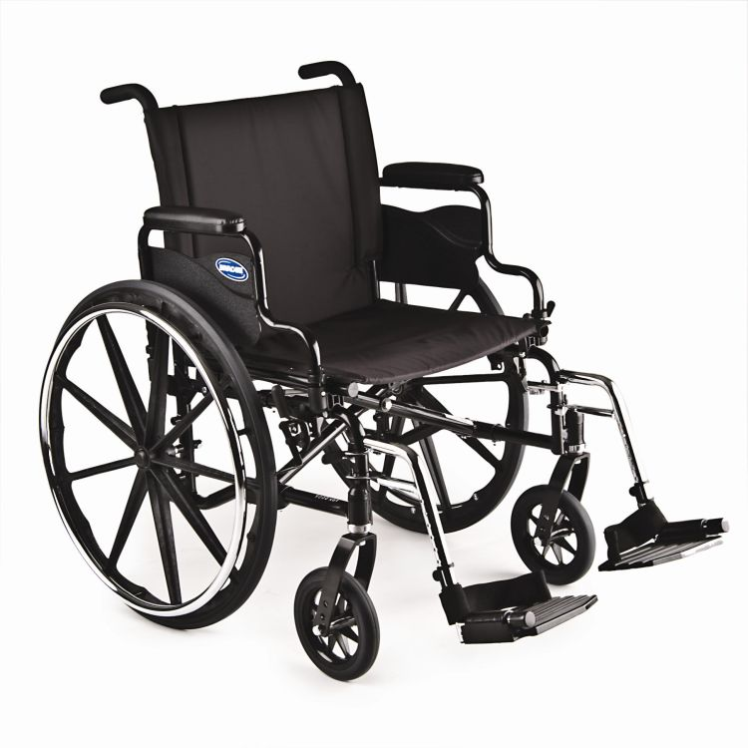
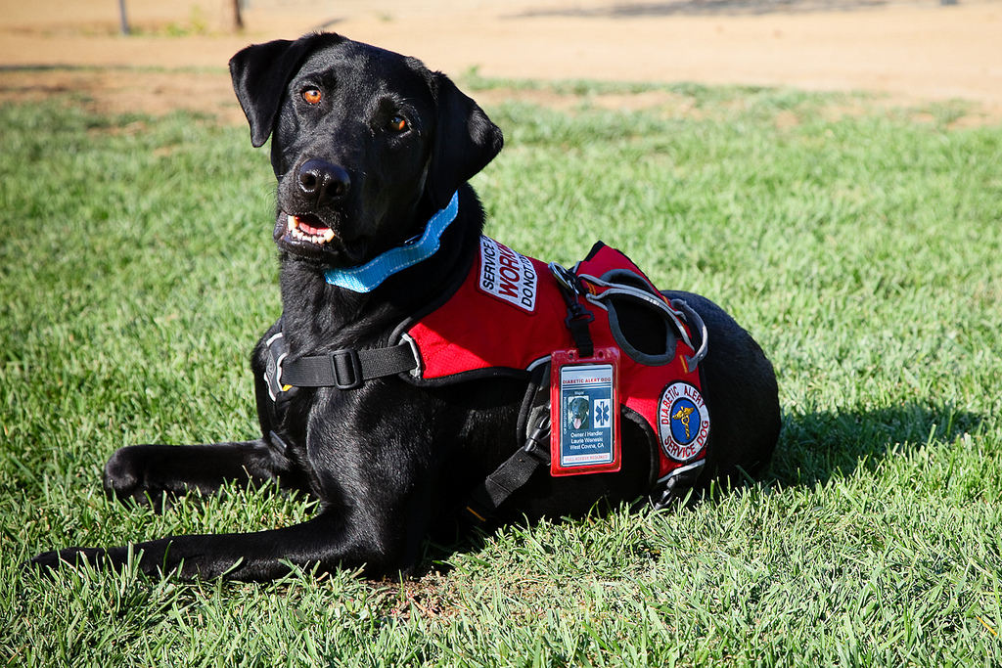
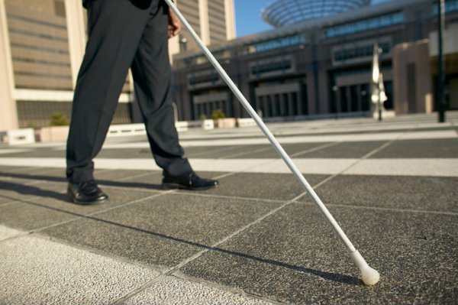
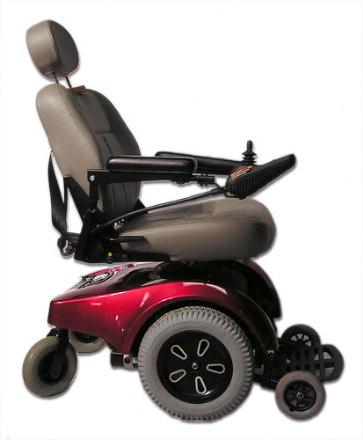
Activites and Adaptations
Tools for independent living
Notes:
People with Various type of disabilities use various types of tools to be comfortable and self-sufficient at home, at school, at work, during leisure time, and while traveling.
Tools for independent living may be basic as a variable-height table. Other tools are more high-tech. People who cannot use their hands, for example, to type on a keyboard or move a computer mouse, can operate computers by talking.

Slide 14
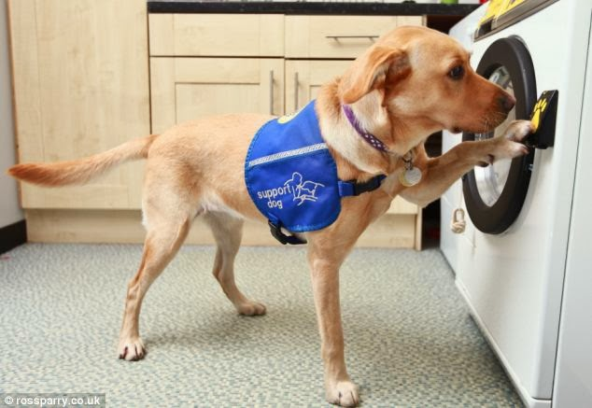
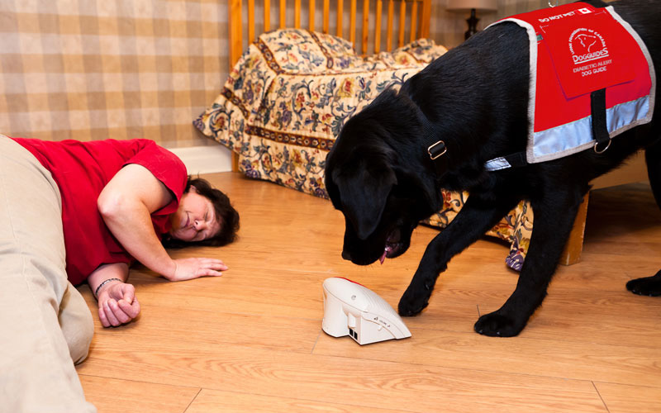
Activities and Adaptations
Service Animals
Guide dogs
Hearing dogs
Assistance dogs
Seizure response dogs
Notes:
Guide dogs can help people who are blind get around safely, quickly, and with confidence. A guide dog responds to its owner’s hand signals and spoken commands. A guide dog is trained to disobey a command that might out its owner in danger. If the owner gives the command “forward’, but the dog sees and obstacle in the way, such a car, the dog will refuse to move forward.
Hearing dogs
People who are deaf or hard of hearing may have hearing dogs to alert them to important sounds: a ringing telephone, a knock on door, an alarm clock buzzing, or a noise that might mean danger. A hearing dog will lead its owner to most sounds. But at the shriek of a smoke alarm, the dog is trained to take its owner to the nearest exit.
Assistance dogs
Can help people with physical or developmental disabilities do to everyday tasks. Assistance dogs can open, and close doors and drawers, flip light switches on and off, retrieve dropped items, and bring or carry objects such as keys, coins, mail, books, a phone, or a water bottle.
Seizure response dogs
A seizure response dog is trained to tun aback and forth from its owner to someone who can , getting the second person’s attention and repeating the alert signal as long as needed. If a dog is alone with its owner, the dog can pull a cord on a call box to bring emergency medical personnel.

Slide 15
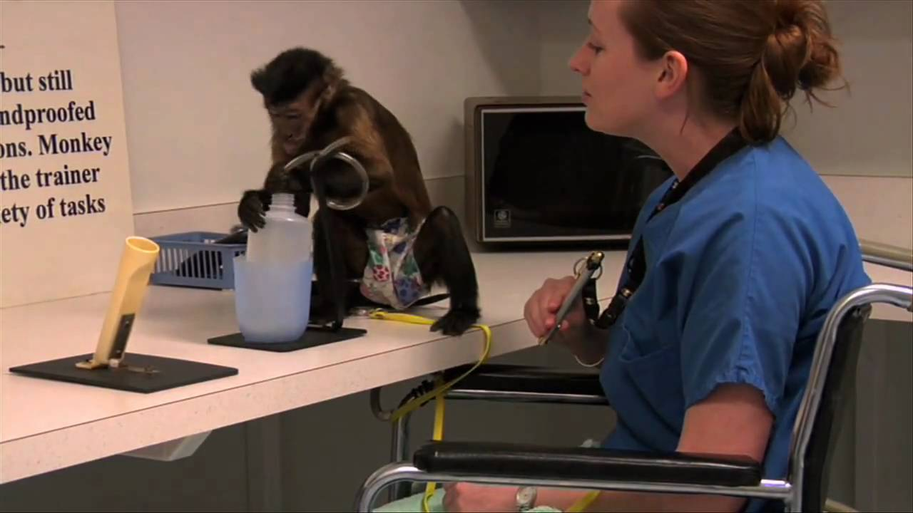
Activities and Adaptations
Service Animals
Monkey helpers
Notes:
Monkey helpers
Capuchin or “organ grinder” monkeys are smart, friendly, nimble-fingered, and particularly well-suited to be trained as monkey helpers. They can help people with many kinds of daily activities: opening doors, holding pencils, operating switches, fetching out-of-reach items, bringing a cool drink, turning the pages of a book, or putting on a video or cd to play.

Slide 16
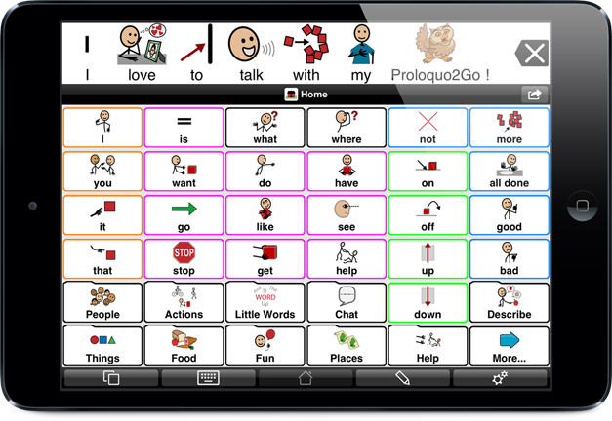
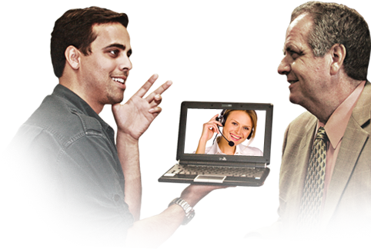
Activities and Adaptations
White Canes
Power Chairs
Augmentative Communication Devices
Video Relay Service
Notes:
White Canes
The white cane is both a tool for travel and a symbol telling others that the person using the cane is blind. The white cane makes blind pedestrians more visible to motorists, helping them travel in greater safety. By tapping the cane from side to side in front of them as they walk, people who are blind or visually impaired can check for objects in the path of travel, find doorways and steps, and locate potential dangers such as holed in the sidewalk or curbs and drop-offs.
Power Chairs
Modern battery-powered wheelchairs hardly resemble the push-from-behind type of wheelchair you may have seen used in hospitals. Most power chairs have variable speed control that can be set between 0 and a top speed of 5 miles per hour. Some power chairs break down into sections to fit in the trunk of a car for transport.
Augmentative Communication Devices
This device enable people who are deaf or hard of hearing to communicate by telephone. They have keyboards for entering messages and monitors that display the conversation as users type back and forth. Users communicate in real time, similar to instant messaging by computer.
Today many people who are deaf or hard of hearing use wireless messaging systems that let the user send and receive email, faxes, and text-to speech/speech-to-text messages.
Video relay service
Video relay service is a new internet video service that lets a person who uses sing language place a call to a hearing person (or vice versa), with a sing language interpreter relaying the conversation. Video relay service allows people to sign rather than type their messages. Most people who are fluent in sing language find signing much faster that pounding a keyboard. Also, communications are clearer because people can use facial expressions and gestures to help get their message across.

Slide 17
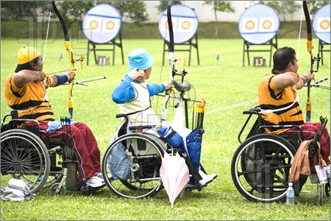
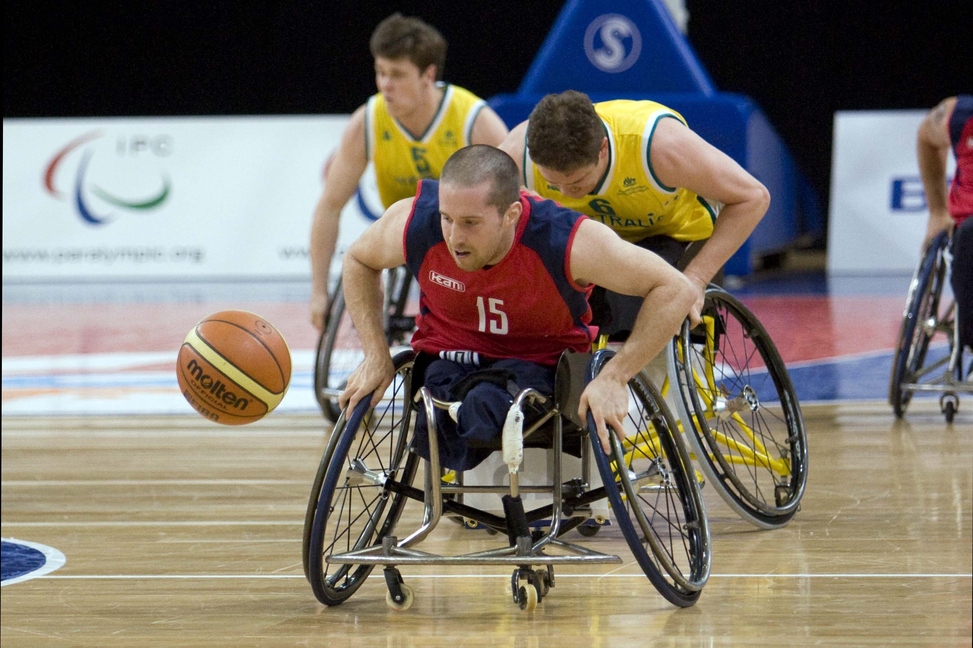
Activities and Adaptations
Adaptive Sports
Adaptive golf
Adaptive snow skiing
Archery
Beep baseball
Sitting Volleyball
Snowboarding
Wheelchair basketball
Wheelchair football
Wheelchair soccer
Wheelchair tennis
Notes:
Many people with disabilities use adaptive equipment to take part in sports and recreational activities. Any sport can be an adaptive sport. Some of the most popular are given on the slide.
Sports need a few modification to be accessible to people with disabilities.
Custom equipment opens other popular sports to people who have disabilities. Adaptive snow-skiing gear includes the bi-ski (two skis with a molded bucket seat for the skier to sit in), a mono-ski ( a one-ski type of sit-down ski), four-track (stand-up skiing using two skis with two handheld outriggers for balance, giving the skier four points of contact with the snow), and three-track (stand-up skiing with one ski and two handheld outriggers).

Slide 18
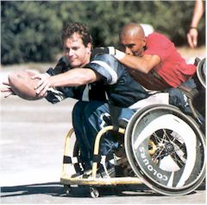
Activities and Adaptations
Can you Adapt?
Test your creativity. Choose one of your favorite activities and think of ways you could adapt it so people with various types of disabilities could enjoy it too.
Will you need to modify rules?
Will you need to create specialized equipment?
Notes:
Test your creativity. Choose one of your favorite activities and think of ways you could adapt it so people with various types of disabilities could enjoy it too.
Use what you have learned about adaptive sports to come up with your own adapted activity. You might invent a new pastime or a new way of playing an old game that will catch on big.
Will you need to modify the rules? The rules of wheelchair basketball, for instance, allow players to hold the ball while pushing once or twice on their wheels. When a player with the ball makes more than two consecutives pushes (without dribbling, passing, or shooting), a travel violation is called.
Will you need to create specialized equipment? Beep baseball is played with a large softball that beeps so player can track it by hearing, not sight.

Slide 19
Disability Awareness
Accessibility

Slide 20
Accessibility
Next time you are in a public place, look at how accessible (usable) the location is for people with disabilities. Are there:
Ramps and Curb-cuts for wheelchair users?
Steps that are low and wide enough to be easily climbed by people using crutches or canes?
Wide doorways?
Elevators?
Signs and directions printed in Braille?
Visual warning signals and directions for people who are deaf?
Notes:
Curbs or steps without ramps, narrow doorways and aisles, revolving doors and turnstiles, high counters, tight parking spaces with no room to maneuver a wheelchair-any of these can make it impossible for people with disabilities to take part in everyday activities such as shopping in a store, watching a movie in a theater, eating at a restaurant, or even going to school or work.
Next time you are in a public place, look at how accessible (usable) the location is for people with disabilities. Are there:

Slide 21
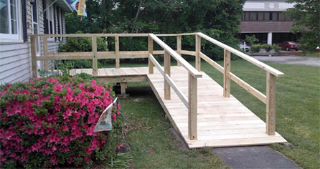
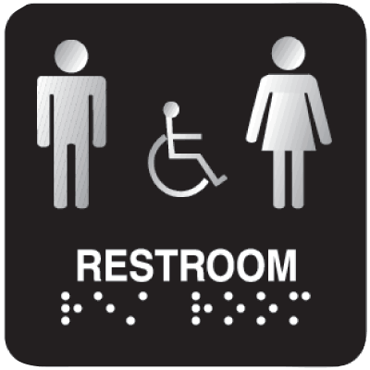
Accessibility
Simple adaptations:
Notes:
There are many types of improvements that can be done to make a location accessible for people with disabilities. Here are some adaptations you or your patrol might make.
Build and install a wooden ramp for wheelchair users
Replace round doorknobs (which must be tightly grasped and twisted) with lever handles that are easier for many people with disabilities to use.
Widen a path so people in wheelchair can use it
Make signs in braille using a slate and stylus (a tool used to write braille much as paper and pencil are used for writing print)

Slide 22
Disability Awareness
Advocacy, Attitudes, and Awareness

Slide 23
Advocacy, Attitudes, and Awareness
Advocacy
Become an Advocate
Notes:
Advocacy means supporting, promoting, or encouraging something. To be an advocate of disabilities awareness means you support and encourage positive attitudes about people who have disabilities. You help strip away the labels so that people can see each other as individuals. You help build bridges of understanding and respect among all people, those with and those without disabilities.
Become an advocate and use what you have learned to put together a disabilities awareness program that you present to a cub scout pack or other group. Teach the group about person-first language and demonstrate its importance while giving your presentation. Or, volunteer your time with an education program or advocacy agency in your school or community.

Slide 24
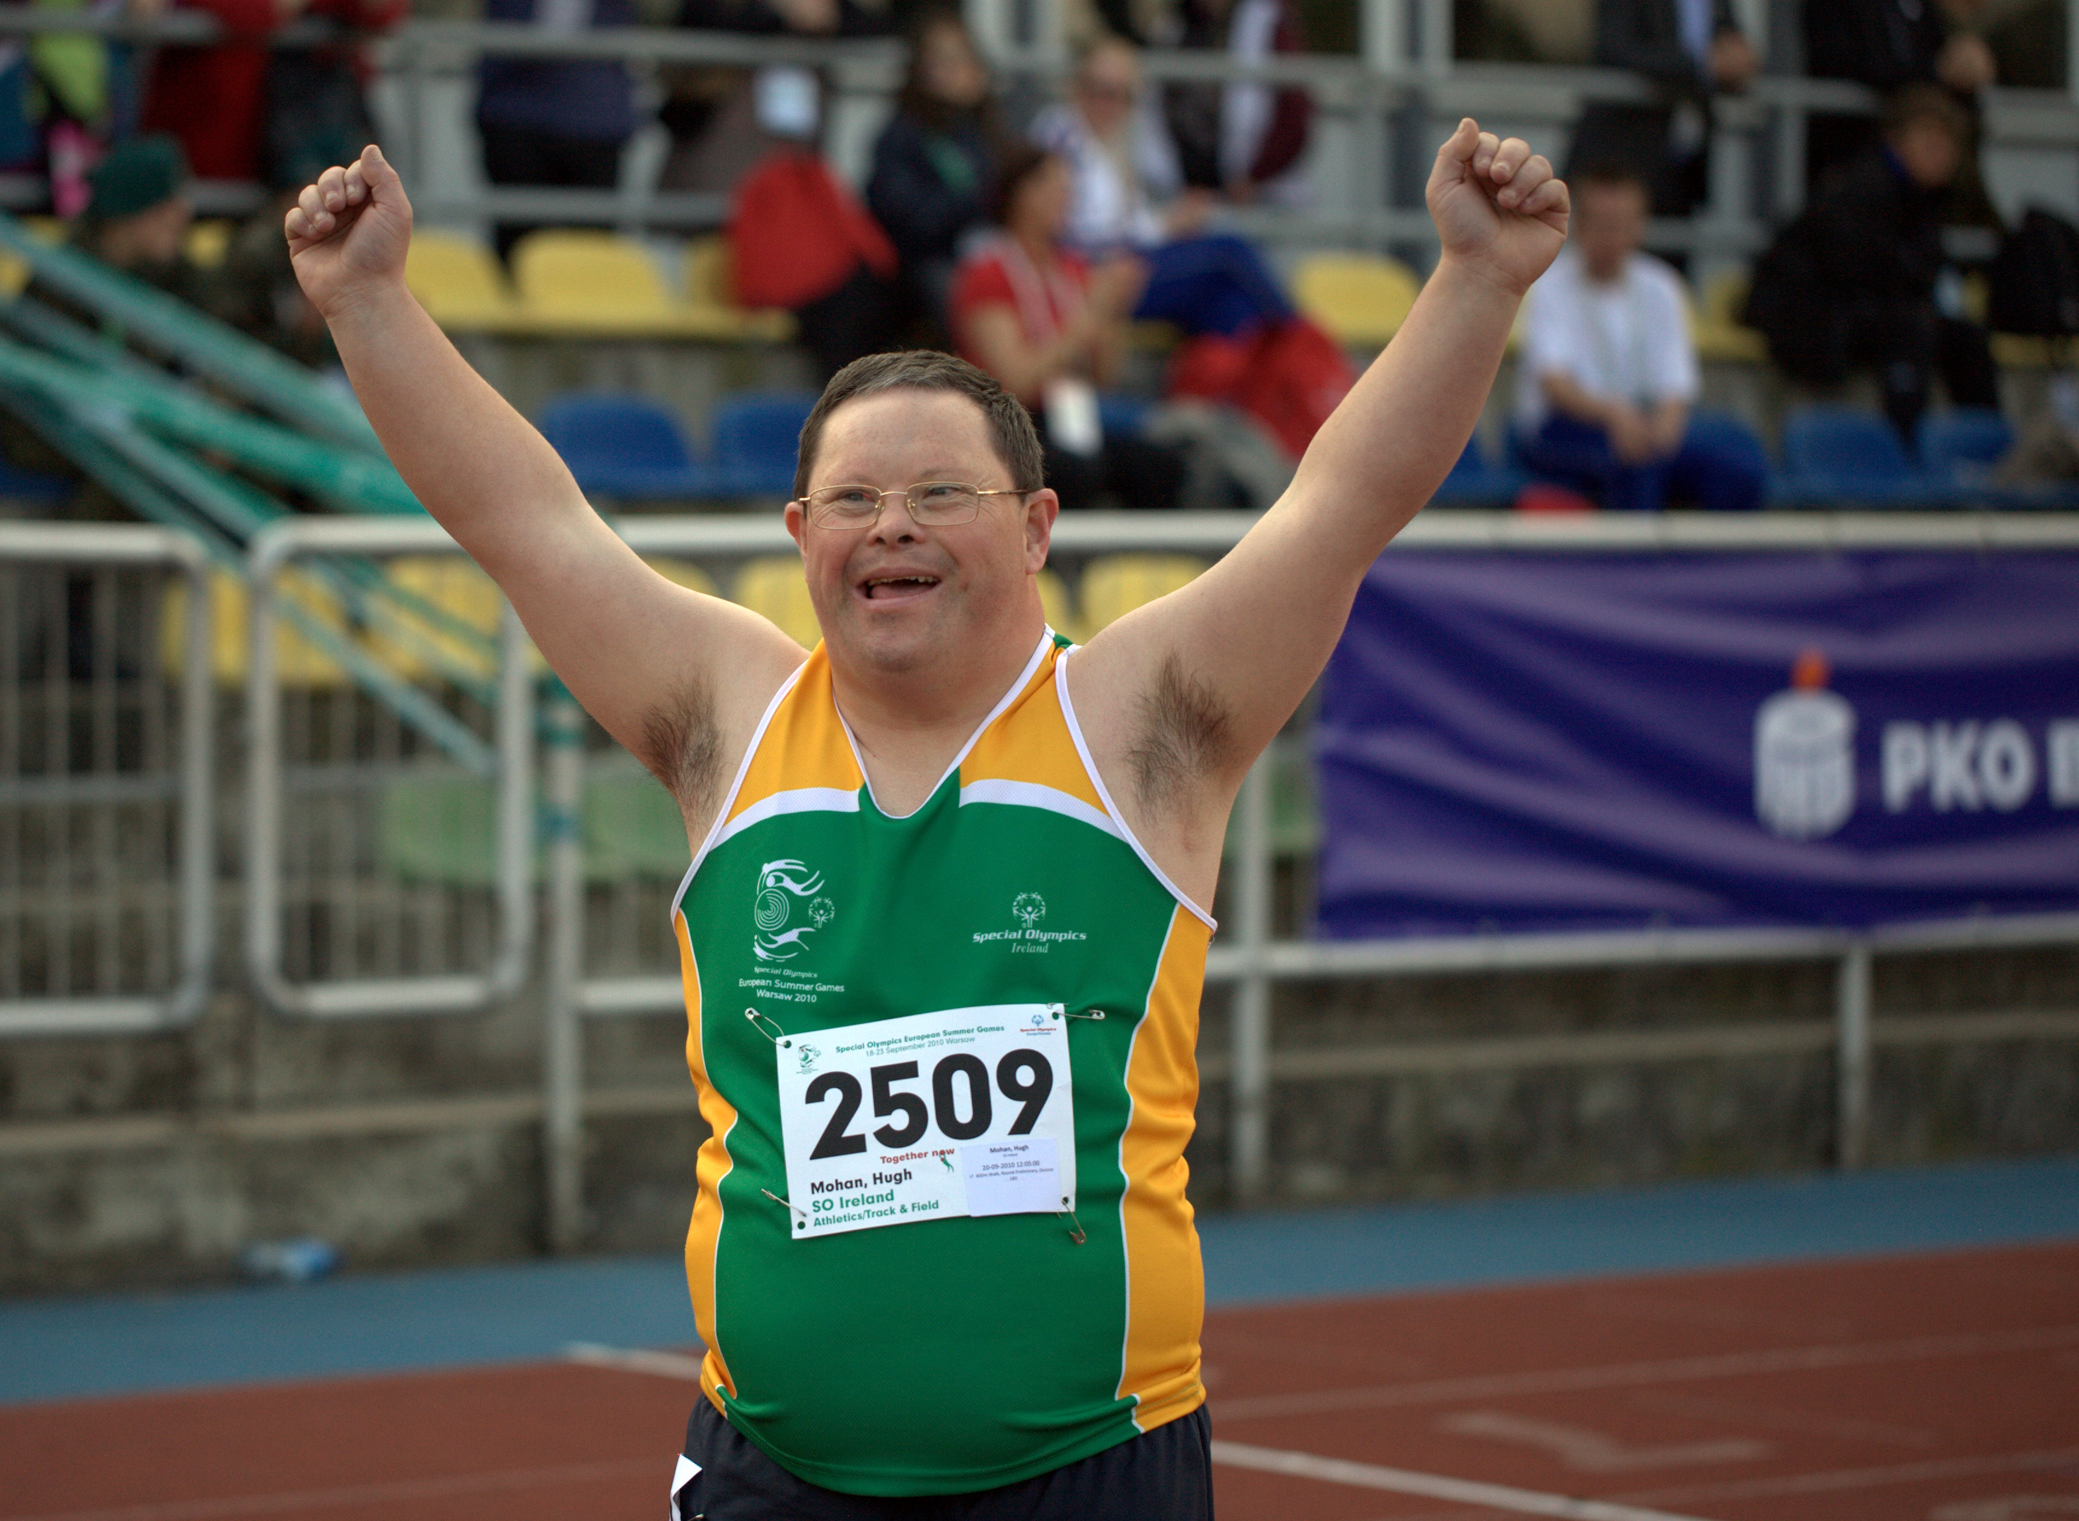
Special Olympics
Notes:
Special Olympics is an international program of games and athletic competition for children and adults who have mental and often physical disabilities. Events are modeled on those of the Olympic games. Boy scouts often take part, both as competitors and as helpers. You might organize your patrol or troop to help at a special Olympics meet.

Slide 25
Advocacy, Attitudes, and Awarenss
Myths and Misconceptions
Myths: a person with a disability is sick
Myths: Only people in wheelchairs or who use crutches are disables
Myths: People with disabilities can do only light work or only simple, repetitive work
Myths: People who are deaf cannot speak
Myths: People who are blind have extra sharp hearing
Notes:
We are all hurt by mistaken ideas and misunderstandings about people with disabilities and what they can and cannot do. Here are some myths you may hear. Learn the facts so you can share the correct information with others
Myths: a person with a disability is sick
Fact: Having a disability is not the same as being sick. Many people with disabilities are in excellent physical condition, healthy, athletic, and strong. Some people who have disabilities also have illnesses, just as some nondisabled people are ill.
Myths: Only people in wheelchairs or who use crutches are disables
Fact: Many disabilities, such as learning or emotional disabilities, cannot be seen or are not obvious.
Myths: People with disabilities can do only light work or only simple, repetitive work
Fact: People with disabilities work successfully in many different trades, businesses, and professions, having the same responsibilities as nondisabled people. Individuals with disabilities have many different skills to offer, the same as everyone else.
Myths: People who are deaf cannot speak
Fact: Deafness does not affect the vocal cords. People with hearing loss may not hear the sounds they make when they speak. Because they are unable to hear the the sound of their voice, some people who are deaf make a conscious choice not to use their voice. Others choose to speak. The age at which the person became deaf also influences speaking ability. Someone who lost his hearing after learning to talk as a child may speak more readily than a person who was born deaf and never heard human speech.
Myths: People who are blind have extra sharp hearing
Fact: Loss of vision does not affect hearing. However, people who are blind may depend more on their hearing and be more alert to sounds than people who are sighted.

Slide 26
Advocacy, Attitudes, and Awareness
Changing Attitudes
Notes:
You have seen that people with disabilities are all individuals. Each person has talents, abilities, feelings, likes, dislikes, wants, and needs. Each person has the right to be treated respectfully, as an individual.
You have also learned that people with disabilities are people first. And maybe you have realized that all people are more alike than different. People are people. Individual variations aside, we are all much the same.

Slide 27
Disability Awareness
Career Opportunities
Notes:
Many types of specialists work with people who have disabilities. Some of the careers you might pursue are described here.

Slide 28
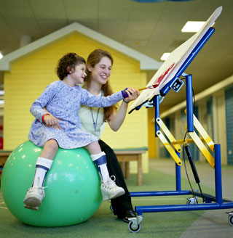
Career Opportunities
Occupational therapists
Notes:
Occupational therapist teach skills to help people with disabilities do the things they need to do. Occupational therapists work in hospitals, clinics, rehabilitation centers, mental health centers, schools, nursing homes, child-care centers, and in some cases patient’s private homes. A bachelor's or master’s degree in occupational therapy is required. College programs include courses in biology, psychology, and occupational therapy theory and practice

Slide 29
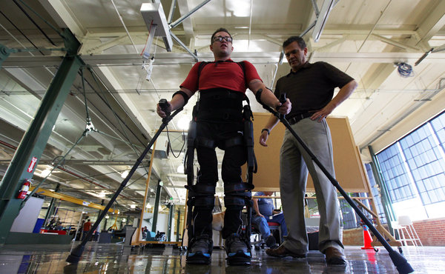
Career Opportunities
Physical therapists
Notes:
Physical therapists use treatments of heat, cold, light, sound, water, and exercise to treat diseases or injuries, build stamina and strength, and restore function to parts of the body. Physical therapy can help prevent, reduce, or relive conditions that affect a person’s physical abilities. Physical therapists work in the same types of places as occupational therapists. Most physical therapists have a master’s degree, but a growing number of them have a doctor of physical therapy degree. Physical therapy studies include courses in anatomy, physiology, psychology, and therapeutic exercise. In the united states, physical therapists must be licenses before they may practice.

Slide 30
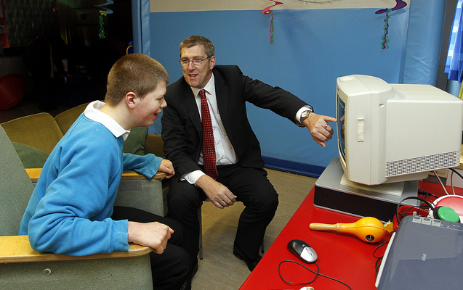
Career Opportunities
Special education teachers
Notes:
Special education teachers help children with disabilities learn to the fullest of their abilities. These teachers may work in schools, homes, hospitals, and institutions. They help students get mainstreamed into regular education classes and succeed in life after leaving school. This career field requires at least a bachelor’s degree and teaching credential.

Slide 31
Career Opportunities
Physician
Notes:
Physicians working with people who have disabilities are especially trained in physical medicine and rehabilitation department that provides patients with physical and occupational therapy. Treatment is usually carried out by a team of specialists that may include physicians, nurses, psychologist, social workers, speech pathologist, and various other therapists.

Slide 32
Career Opportunities
Audiologists
Speech Therapists
Psychologists
Physicians

Slide 33
The End

